Slide 1


Implementation of Chatbot Using NLP
By Mayank Jaiswal

Slide 2

Learning Objectives
Understand intent-based chatbots and NLP techniques
Learn how to use Logistic Regression for text classification
Implement a Streamlit-based chatbot interface
Extract intents and entities from user input
Improve chatbot responses using ML techniques
GOAL
Source :
www.freepik.com/

Slide 3
Tools and Technology used
The chatbot is built using Natural Language Processing (NLP) and Machine Learning (ML),
with the help of various Python libraries.
Below is a breakdown of the key tools and technologies used:
🛠 Libraries & Technologies
Technology | Purpose
NLTK (Natural Language Toolkit) 📝 | Used for text preprocessing like tokenization, stemming, and stopword removal.
TfidfVectorizer (from Scikit-learn) 📊 | Converts text into numerical format for ML models using TF-IDF (Term Frequency - Inverse Document Frequency).
Logistic Regression (from Scikit-learn) ⚙️ | A classification algorithm used to predict the intent of user input.
JSON & CSV 📂 | Stores chatbot training data (intents, entities, and responses).
Streamlit 🌐 | A Python framework used to create a simple, interactive chatbot interface.
Random Module 🎲 | Helps in selecting randomized responses for a more human-like interaction.
OS & Datetime 🖥 | Handles file operations and time-based functions.

Slide 4
Methodology
1️⃣ Data Collection & Preparation – A dataset containing labeled intents, entities, and responses is created and stored in a structured format like JSON or CSV.
2️⃣ Text Preprocessing – User input is cleaned by converting text to lowercase, removing stopwords, and applying stemming to extract meaningful words.
3️⃣ Feature Extraction – The processed text is converted into numerical format using TF-IDF vectorization to help the machine learning model understand patterns.
4️⃣ Model Training – A Logistic Regression model is trained to classify user inputs into predefined intents based on the extracted features.
5️⃣ Response Generation – Once an intent is identified, the chatbot selects an appropriate response from a predefined set to maintain natural conversation flow.
6️⃣ Building the Chatbot Interface – A simple and interactive web interface is developed using Streamlit to allow users to communicate with the chatbot in real time.
7️⃣ Testing & Optimization – The chatbot is tested with different inputs, and improvements are made by refining the dataset and adjusting model parameters.
8️⃣ Future Enhancements – Plans for integrating deep learning models, contextual memory, and voice-based interactions to improve chatbot performance and user experience.

Slide 5
Problem Statement:
Traditional rule-based chatbots struggle to understand natural language and lack flexibility in responding to user queries. There is a need for an AI-powered chatbot that can accurately classify user intents, extract relevant entities, and generate meaningful responses using NLP and Machine Learning techniques.
❌ Problem:
Traditional rule-based chatbots lack flexibility
Need for an AI-driven chatbot to understand intents
Improving user interaction with NLP techniques

Slide 6
Solution:
To address this issue, we developed an AI-powered chatbot using Natural Language Processing (NLP) and Logistic Regression. The chatbot:
✅ Understands user intents by processing text with NLP techniques. ✅ Extracts key entities to improve response accuracy. ✅ Uses TF-IDF vectorization for better text representation. ✅ Classifies user queries using a trained Logistic Regression model. ✅ Provides dynamic responses based on predefined intent-based datasets. ✅ Features a user-friendly web interface built with Streamlit for real-time interaction.

Slide 7
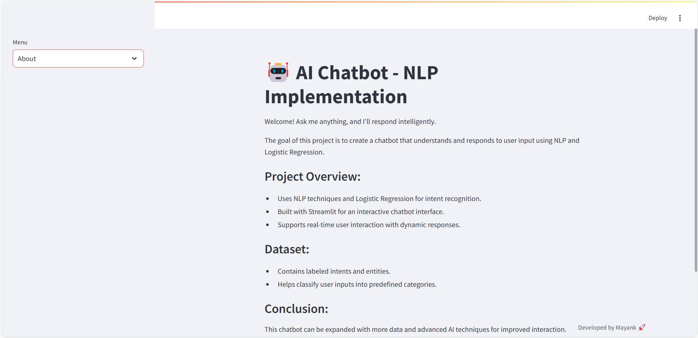
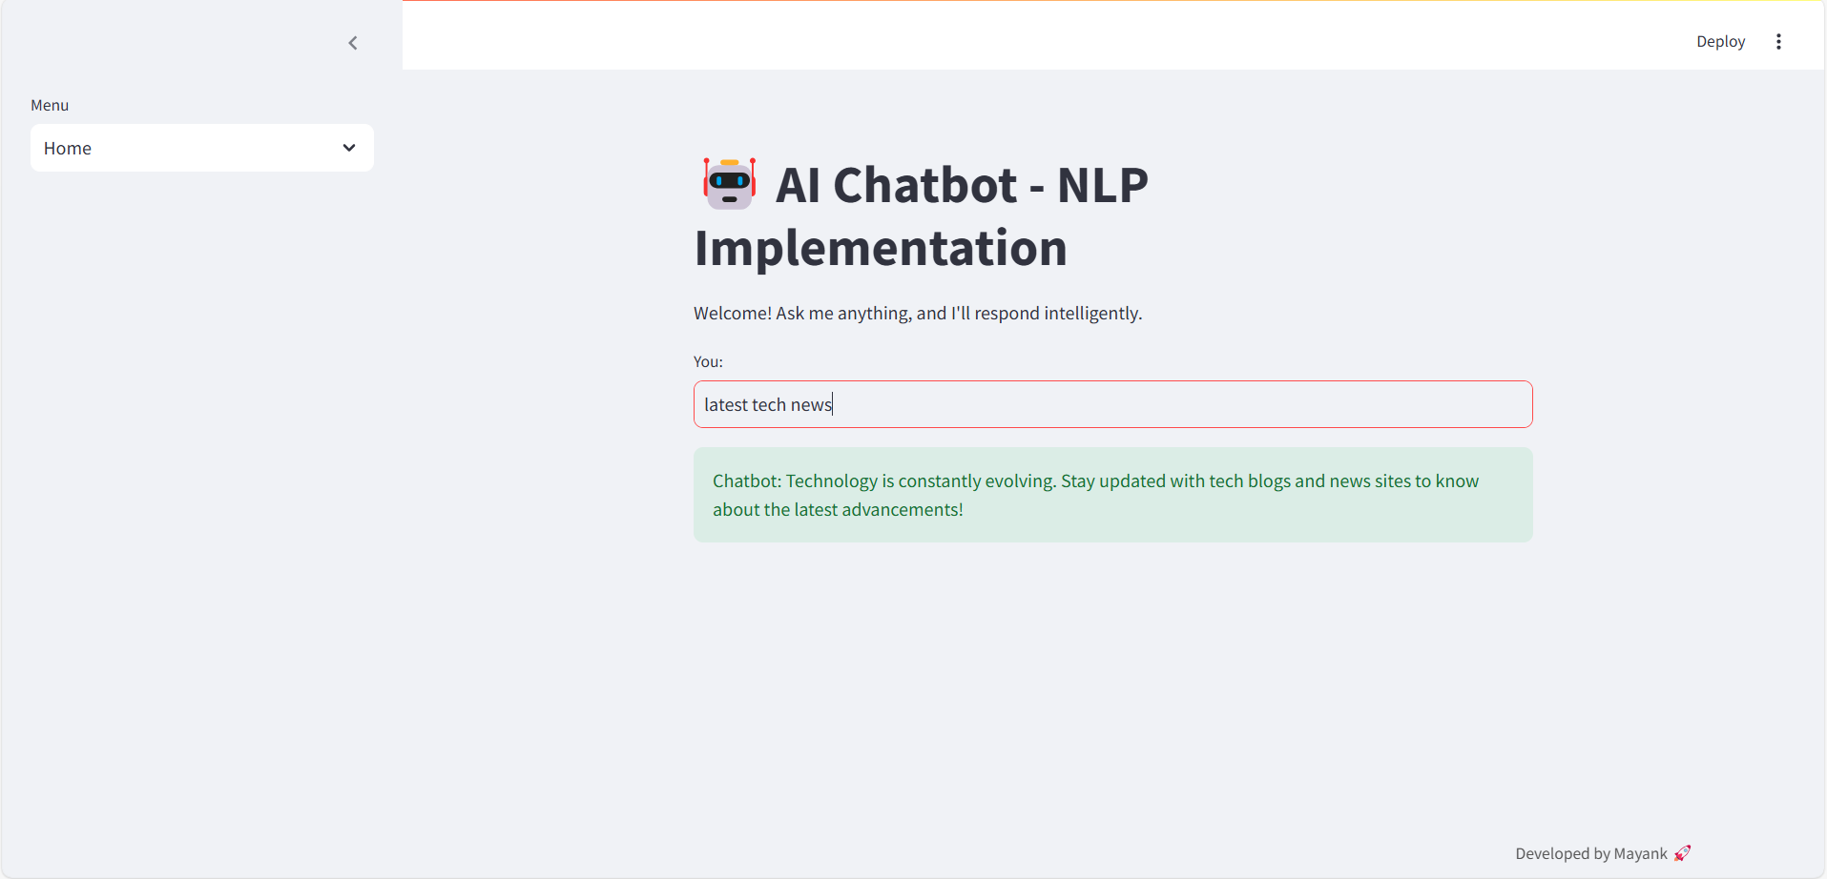
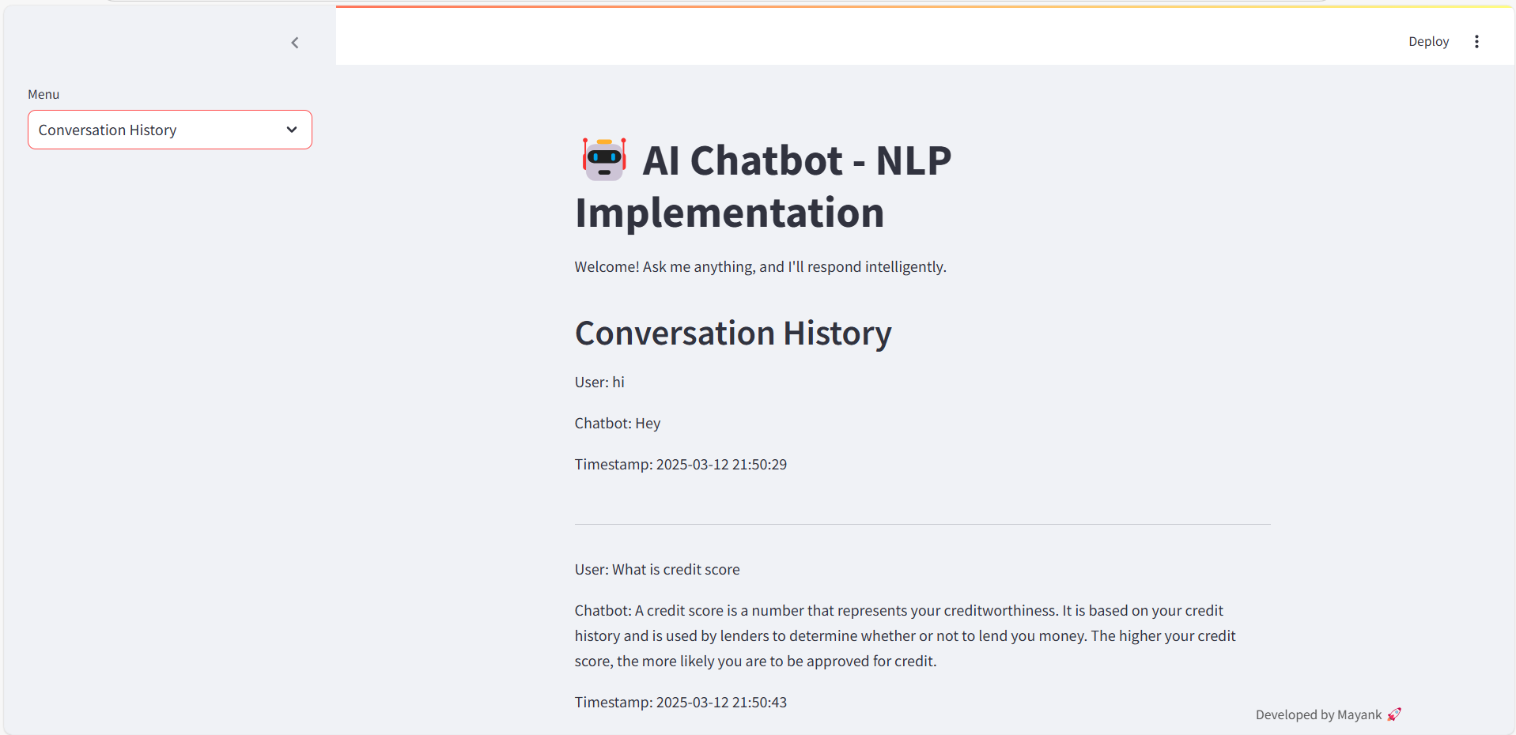
Screenshot of Output:

Slide 8
Conclusion:
Successfully built a chatbot that understands user intents
Integrated NLP techniques with Logistic Regression
Deployed using Streamlit for real-time user interaction
🚀 Future Enhancements:
Add deep learning models (LSTMs, Transformers) for better accuracy
Use pretrained language models (BERT, GPT)
Enhance chatbot’s conversation memory

